Slide 1
Getting used to rats
AR / VR Project

Slide 2
Motivation
Many people are afraid of rats
disgusting
unclean
scary
They are wrong
cute
smart
social
© Thomas Ott

Slide 3
Problem
We need to show them
No real rats
Interaction
Engagement
© Thomas Ott

Slide 4
Solution
Let them interact with virtual rat
Make it look smart
Incorporate rat facts
© Thomas Ott
https://www.turbosquid.com/de/3d-models/rat-rigged-3d-model-1661448

Slide 5
Details
Guide the rat with hand gestures
will seem smart
3rd person
no motion sickness
“real“ scenario
Seamlessly add factoids

Slide 6
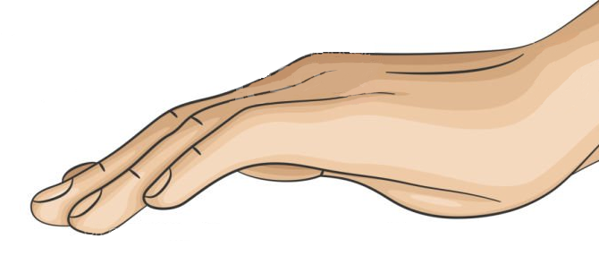
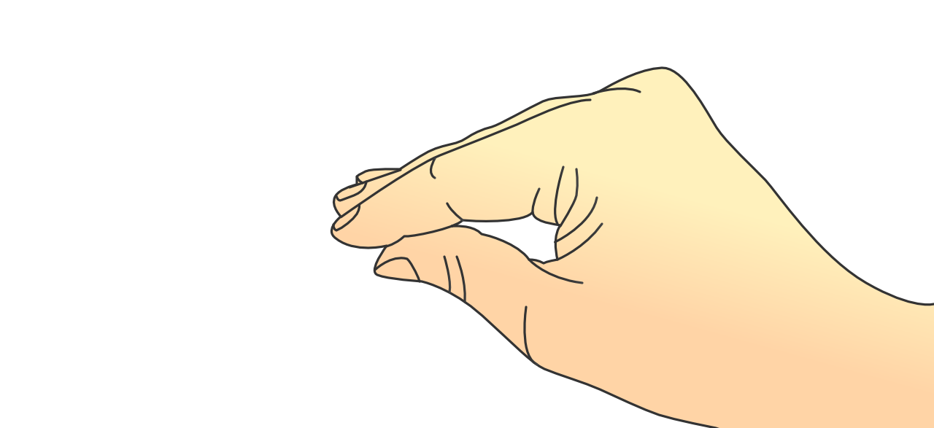
Movement methods
walk forwards
run forwards
right hand only
both hands
x
walk backwards (won‘t be implemented) (Have u seen a rat moving backwards for longer?)
stay (default)
only right hand
stand on the hind legs
jump
both hands
stay on all four legs
pick up items
put away left hand
running direction = line of sight / running direction = line of sight of the hands
rotate objects through angle of the hand / angle of the head

